Slide 1
Data Structures: Heaps
For: CSCI 61
By: Navid Shaghaghi

Slide 2
Heap
A binary tree where a less than operator forms a strict weak ordering that can be used to compare the node’s entries.
Heap Storage Rules:
The entry contained by a node is never less than the entries of the node’s children
The tree is a complete binary tree, so that every level except the deepest must contain as many nodes as possible; and at the deepest level, all the nodes are as far left as possible.
See Example on board

Slide 3
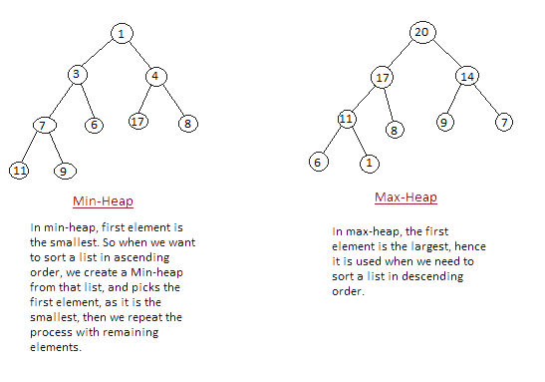
Min and Max Heaps

Slide 4
Heap Implementation
A Heap is a binary tree so it can be implemented using:
A fixed-size array
A dynamic array
Binary tree nodes

Slide 5
Adding an entry to a Heap
Place the entry in the heap in the first available location.
This keeps the structure as a complete binary tree
But it might no longer be a heap since the new entry’s parent might be less than the new entry
Reheapificate: While the new entry’s parent is less than the new entry, swap the new entry with its parent (this process is called upward reheapification)

Slide 6
Removing an entry from a Heap
Copy the entry at the root of the heap to the variable that is used to return a value
Copy the last entry in the deepest level to the root, and then take this last node out of the tree. This entry is called the “out-of-place” entry.
While the out-of-place entry is less than its children, swap the out-of-place entry with its highest child.
Return the answer that was saved in step 1

Slide 7
Priority Queue
Similar to a regular queue, items are places in a queue and then taken out.
But unlike a regular queue, each entry in a priority queue can be compared with the other entries using a less than operator.
Although there are other ways to implement a priority queue, the best way is via a heap.

Slide 8
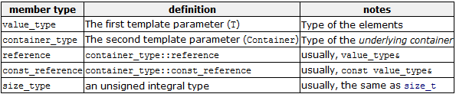
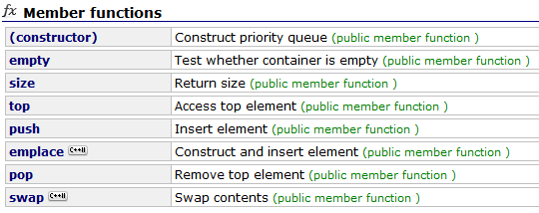
The STL <priority_queue> class

Slide 9
Select STL <priority_queue> class methods
top() – Returns the highest priority item of the priority queue but doesn’t remove it from the queue
pop() – Removes the highest priority item of the priority queue
push(const Item& entry) – Adds an item to the rear of the priority queue
empty() – Returns True if priority queue is empty
size() – Returns the number of items in the priority queue

